Slide 1
JavaServer Faces (JSF) Basics

Slide 2
What is & Why JSF?

Slide 3
JavaServer™ Faces (JSF)
A server side user interface component framework for Java™ technology-based web applications

Slide 4
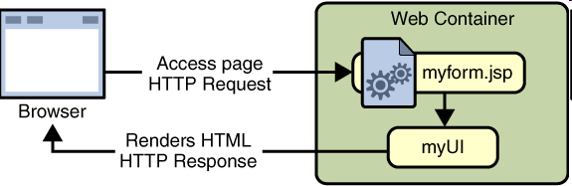
JSF

Slide 5
What is JSF?
A specification and reference implementation for a web application development framework
Components
Events
Validators
Back-end-data integration
Designed to be leveraged by tools
- Sun Java Studio Creator
JDeveloper
WSAD

Slide 6
Why JSF? (page 1)
MVC for web applications
Clean separation of roles
Easy to use
Extensible Component and Rendering architecture
Support for client device independence
Standard
Huge vendor and industry support

Slide 7
Why JSF? (page 2)
Offers finer-grained separation of behavior and presentation than JSP
Component-specific event handling
UI elements as stateful objects on the server
UI-component and Web-tier concepts without limiting you to a particular scripting technology or markup language
Can work with any presentation technology including JSP

Slide 8
Why JSF? (page 3)
JSP and Servlet
No built-in UI component model
Struts
No built-in UI component model
No built-in event model for UI components
No built-in state management for UI components
No built-in support of multiple renderers (Struts is more or less tied up with HTML)
Not a standard (despite its popularity)
Struts and JSF can be used together

Slide 9
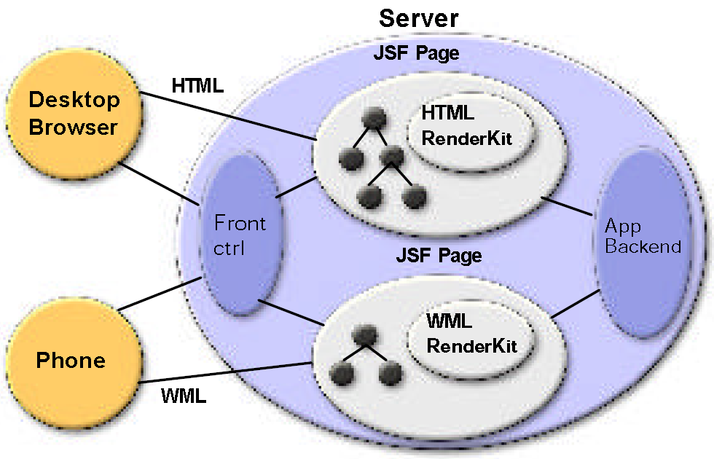
JSF Architecture

Slide 10
Important Basic Capabilities
Extensible UI component model
Flexible rendering model
Event handling model
Validation framework
Basic page navigation support
Internationalization
Accessibility

Slide 11
Key JSF Concepts
UIComponent
Render-independent characteristics
Base class with standard behaviors
Standard UIComponent Subclasses:
UICommand, UIForm, UIGraphic, UIInput,
UIOutput, UIPanel, UISelectBoolean,
UISelectMany, UISelectOne
FacesEvent
Base class for request and application events
Validator
Base class for standard and application defined validators

Slide 12
Key JSF Concepts
Converter
Plug-in for String-Object conversion
FacesContext – Per-Request State:
Servlet request, response, session
JSF request, response trees
JSF Expression Language
Model reference expression evaluators
Syntax similar to the expression language of the JSP Standard Tag Library (JSTL) 1.0
Primary interface between components and the data provided by (or to) the application

Slide 13
Key JSF Concepts
Renderer – Converts components to and from a specific markup language
Supports render-dependent attributes on components
May support more than one component typ
RenderKit – Library of Renderers
Extensible at runtime
Basic HTML RenderKit is part of the specification

Slide 14
Request Processing Life Cycle

Slide 15
Lifecycle of JSF Page
A JSF page is represented by a tree of UI components, called a view
When a client makes a request for the page, the lifecycle starts
During the lifecycle, JSF implementation must build the view while considering state saved from the previous postback
When the client performs a postback of the page, JSF implementation must perform lifecycle steps
validation
conversion

Slide 16
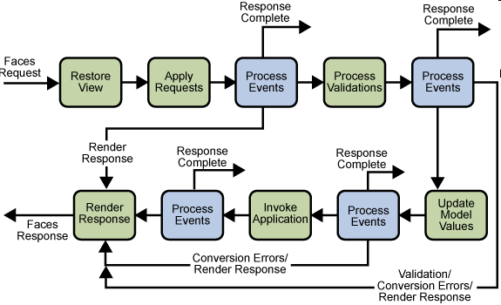
Life Cycle of a JSF page

Slide 17
Request Processing
Life-cycle handles two types of requests
Initial request & Postback
Initial request
A user requests the page for the first time
Lifecycle only executes the restore view and render response phases
Post back
A user submits the form contained on a page that was previously loaded into the browser as a result of executing an initial request
Lifecycle executes all phases

Slide 18
Request Processing Lifecycle Phases
Reconstitute component tree phase (Restore View)
Apply request values phase
Process validations phase
Update model values phase
Invoke application phase
Render response phase

Slide 19

Phase 1: Reconstitute Component Tree (View) Phase
When a request for a JavaServer Faces page is made, such as when clicking on a link or a button, the JSF implementation begins the Restore view phase
if it is the first time, an empty view is created
JSF implementation performs
builds the view of the JavaServer Faces page
wires up event handlers and validators
saves the view in the FacesContext

Slide 20
Phase 2: Apply Request Values Phase
Each component in the tree extracts its new value from the request parameters with its built-in decode method
Within the decode method, the value is then converted to right type then stored locally on the component
the data entered into the fields get converted to right type
Conversion errors are queued on the FaceContext

Slide 21
Phase 3: Process Validation Phase
JSF implementation processes all input validations registered on the components in the tree
This is input validation (not business logic validation)
In case of validation errors
Error messages are queued in FacesContext
Lifecycle advances directly to the Render Response phase

Slide 22
Phase 4: Update Model Values Phase
JSF implementation walks the component tree and set the corresponding server side object properties to the components' local values
Update the bean properties pointed at by an input component's value attribute
Type conversion from local value to model property type

Slide 23
Phase 5: Invoke Application Phase
JSF implementation handles any application-level events, such as submitting a form or linking to another page

Slide 24
Phase 6: Render Response Phase
JSF implementation invokes the components' built-in encode method and renders the components from the component tree saved in the FacesContext
Create appropriate markup from component tree
If errors in previous phases, original page is rendered with any queued error messages
State of the response is saved so that subsequent requests can access it and it is available to the Restore View phase

Slide 25
UI Component Model

Slide 26
Sub Topics
What is a UI component?
UI component classes
UI component rendering model
Conversion model
Event and listener model
Validation model

Slide 27
UI Component Model
What is a UI Component?

Slide 28
What is a UI Component?
A well defined, familiar idiom for UI design
Are configurable, reusable elements that compose the user interfaces of JSF applications
Can be simple, like a button, or compound, like a table, which can be composed of multiple components
Extensible through composition, adding new components
Accessible via JSF custom tags in JSP page, for example

Slide 29
JSF UI Component Model
A set of UIComponent classes for specifying the state and behavior of UI components
A rendering model that defines how to render the components in different ways.
An event and listener model that defines how to handle component events
A conversion model that defines how to plug in data converters onto a component
A validation model that defines how to register alidators onto a component

Slide 30
UI Component Classes

Slide 31
UI Component Classes
UI Component classes specify all of the UI component functionality
Retrieving values from input form (decoding)
Holding component state
Maintaining a reference to model objects
Driving event-handling
Rendering – creating markup (encoding)

Slide 32
UI Component Classes
JSF implementation provides a set of UI component classes
Developers can extend these UI component classes to create custom UI components
All JSF UI component classes extend from UIComponentBase
UIComponentBase defines the default state and behavior of a UIComponent

Slide 33
How UI Component classes are used by Page authors?
Most page authors and application developers will not have to use these classes directly
They will instead include the components on a page by using the component's corresponding tags
Most of these component tags can be rendered in different ways
For example, a UICommand component can be rendered as a button or a hyperlink using different tags

Slide 34
Built-in UI Component Classes
UICommand:
Represents a control that fires actions when activated.
UIForm:
Encapsulates a group of controls that submit data to the application. This component is analogous to the form tag in HTML.
UIGraphic:
Displays an image.

Slide 35
Built-in UI Component Classes
UIInput:
Takes data input from a user is a subclass of UIOutput
UIOutput:
Displays data output on a page
UIPanel
Displays a table
UIParameter:
Represents substitution parameters

Slide 36
Built-in UI Component Classes
UISelectItem:
Represents a single item in a set of items.
UISelectItems:
Represents an entire set of items.
UISelectBoolean:
Allows a user to set a boolean value on a control by selecting or de-selecting it. This class is a subclass of UIInput.
UISelectMany:
Allows a user to select multiple items from a group of items. This class is a subclass of UIInput.

Slide 37
Built-in UI Component Classes
UISelectOne:
Allows a user to select one item out of a group of items.This class is a subclass of UIInput.

Slide 38
UI Component Model:
Component Rendering Model

Slide 39
Component Rendering
Rendering is handled by Render kit not by component classes
Component writers can define the behavior of a component once, but create multiple renderers
Page authors and application developers can change the appearance of a component on the page by selecting the tag that represents the appropriate component/renderer combination
<h:commandButton>
<h:commandLink>

Slide 40
RenderKit
Defines how component classes map to component tags appropriate for a particular client
JSF implementation includes a built-in RenderKit for rendering to an HTML client
For every UI component that a RenderKit supports, the RenderKit defines a set of Renderer objects

Slide 41
Renderer Object
Defines a different way to render the particular component to the output defined by the RenderKit
Example
UISelectOne component has three different renderers
One of them renders the component as a set of radio buttons
Another renders the component as a combo box.
The third one renders the component as a list box.

Slide 42
JSP Custom Tags in HTML Renderer Kit

Slide 43
Tags in HTML Renderer Kit
Each JSP custom tag defined in the standard HTML RenderKit class is composed of
component functionality, defined in the UIComponent class
rendering attributes, defined by the Renderer

Slide 44
Example Tags
<commandButton> & <commandLink> tags
“command” defines UI component
“Button” and “Link” defines rendering attribute

Slide 45
UI Component Model:
Conversion Model

Slide 46
Conversion Model
A component can be associated with server-side model object data
Two views of the component's data:
model view
presentation view
Component's data can be converted between the model view and the presentation view
This conversion is usually performed automatically by the component's renderer
Custom conversion is supported via Converter

Slide 47
UI Component Model:
Event & Listener Model

Slide 48
JSF Event & Listener Model
Similar to JavaBeans event model
Listener and Event classes that an application can use to handle events generated by UI components
An Event object identifies the component that generated the event and stores information about the event
To be notified of an event, an application must provide an implementation of the Listener class and register it on the component that generates the event
When the user activates a component, such as by clicking a button, an event is fired

Slide 49
UI Component Model:
Validation Model

Slide 50
Validation Model
Like the conversion model, the validation model defines a set of standard classes for performing common data validation checks
jsf-core tag library also defines a set of tags that correspond to the standard Validator implementations
Most of the tags have a set of attributes for configuring the validator's properties
minimum and maximum

Slide 51
ApplicationConfiguration

Slide 52
Application Configuration File
XML file for configuring resources required at application startup time
navigation rules, converters, validators, render kits
Usually named as faces-config.xml
A <faces-config> tag must enclose all of the other declarations
<faces-config>
....
</faces-config>

Slide 53
faces-config.xml
<?xml version="1.0"?>
<!DOCTYPE faces-config PUBLIC
"-//Sun Microsystems, Inc.//DTD JavaServer Faces Config 1.0//EN"
"http://java.sun.com/dtd/web-facesconfig_1_0.dtd">
<faces-config>
<application>
<locale-config>
<default-locale>en</default-locale>
<supported-locale>de</supported-locale>
<supported-locale>fr</supported-locale>
<supported-locale>es</supported-locale>
</locale-config>
</application>

Slide 54
faces-config.xml (2)
<navigation-rule>
...
<from-view-id>/greeting.jsp</from-view-id>
...
</navigation-rule>
<navigation-rule>
...
<from-view-id>/response.jsp</from-view-id>
...
</navigation-rule>
<managed-bean>
...
<managed-bean-name>UserNumberBean</managed-bean-name>
...
<managed-bean>
</faces-config>

Slide 55
Application Configuration File
You can have more than one application configuration file
There are three ways that you can make these files available to the application
A resource named /META-INF/faces-config.xml in any of the JAR files in the Web application's /WEB-INF/lib directory
A context init parameter, javax.faces.application
A resource named faces-config.xml in the /WEB-INF/ directory of your application (most common)

Slide 56
Getting Started with JSF

Slide 57
Creating a JSF Application

Slide 58
Requirement
A web Development Directory Structure
web.xml
JSF Specific Steps
Deployment

Slide 59
Development Directory Structure
Same development directory structure for any typical Web application
ContextRoot
/*.jsp files
/images/*.jpg,*.gif etc
/WEB-INF
/classes
/lib

Slide 60
Jar Files for JSF Application(1)
jsf-api.jar
– contains the javax.faces.* API classes
jsf-impl.jar
– contains the implementation classes of the JavaServer Faces standard implementation
jstl.jar
– required to use JSTL tags and referenced by JavaServer Faces standard implementation classes

Slide 61
*.jar files (2)
standard.jar
required to use JSTL tags and referenced by JavaServer Faces reference implementation classes
commons-beanutils.jar
utilities for defining and accessing JavaBeans component properties
commons-digester.jar
– for processing XML documents

Slide 62
*.jar files (3)
commons-collections.jar
– extensions of the Java 2 SDK Collections Framework
commons-logging.jar
– a general purpose, flexible logging facility to allow developers to instrument their code with logging statements

Slide 63
web.xml
Same structure as any other Web application
javax.faces.webapp.FacesServlet is like any other servlet
Servlet definition and mapping of FacesServlet
There are several JSF specific
<context-param> elements

Slide 64
Example web.xml
1 <web-app>
2 <display-name>Name of the application
3 </display-name>
4 <description>
5 Description for the Application
6 </description>
7
8 <context-param>
9 <param-name>javax.faces.STATE_SAVING_METHOD</param-name>
10 <param-value>client</param-value>
11 </context-param>
12
13 <context-param>
14 <param-name>javax.faces.application.CONFIG_FILES</param-name>
15 <param-value>/WEB-INF/faces-config.xml</param-value>
16 </context-param>
17
18 <context-param>
19 <param-name>com.sun.faces.validateXml</param-name>
20 <param-value>true</param-value>
21 </context-param>

Slide 65
Example web.xml(2)
22<listener>
23<listener-class>com.sun.faces.config.ConfigListener</listener-class>
</listener>
24<!-- Faces Servlet -->
25<servlet>
26 <servlet-name>Faces Servlet</servlet-name>
27 <servlet-class>javax.faces.webapp.FacesServlet</servlet-class>
28 <load-on-startup> 1 </load-on-startup>
29</servlet>
30 <!-- Faces Servlet Mapping -->
31 <servlet-mapping>
32<servlet-name>Faces Servlet</servlet-name>
33<url-pattern>*.faces</url-pattern>
34</servlet-mapping>
35</web-app>

Slide 66
JSF-Specific Development Steps
1.Create the Page
Using the UI component and core tags
2.Define Page Navigation
In the application configuration file
3. Deploy and Run
use tomcat web container

Slide 67
Two Tag Libraries
html basic
Defines tags for representing common HTML user interface components
jsf-core
Defines other JSF related tags
Independent of any rendering technology
JSP page need to declare them
<%@ taglib uri="http://java.sun.com/jsf/html/" prefix="h" %>
<%@ taglib uri="http://java.sun.com/jsf/core/" prefix="f" %>

Slide 68
Create the page (view.jsp)
<html>
<%@taglib uri="http://java.sun.com/jsf/html" prefix="h" %>
<%@ taglib uri="http://java.sun.com/jsf/core" prefix="f" %>
<head>
<title>My JSF 'index.jsp' starting page</title>
</head>
<body>
<f:view>
<h:outputText value="This is my JSF JSP page."/> <br>
<h:commandButton value=“go to next page” action=“next”/>
</f:view>
</body>
</html>

Slide 69
Create the page (welcome.jsp)
<html>
<%@taglib uri="http://java.sun.com/jsf/html" prefix="h" %>
<%@ taglib uri="http://java.sun.com/jsf/core" prefix="f" %>
<head>
<title>My JSF 'index.jsp' starting page</title>
</head>
<body>
<f:view>
<h:outputText value=“This is Welcome Page"/> <br>
</f:view>
</body>
</html>

Slide 70
Define Page Navigation
<!DOCTYPE faces-config PUBLIC
"-//Sun Microsystems, Inc.//DTD JavaServer Faces Config 1.1//EN"
"http://java.sun.com/dtd/web-facesconfig_1_1.dtd">
<faces-config>
<navigation-rule>
<from-view-id>/view.jsp</from-view-id>
<navigation-case>
<from-outcome>next</from-outcome>
<to-view-id>/welcome.jsp</to-view-id>
</navigation-case>
</navigation-rule>
</faces-config>

Slide 71
Deploy and Run the application
Start Tomcat
Copy the web aplication to <tomcat-home>/webapps
Access the JSF page using the url
http://localhost:8080/Context_root/view.faces

Slide 72
End

Slide 73
Application Class
When an application starts up, the JSF implementation creates a single instance of the Application class
Is automatically created for each application
FacesContext.getApplication()

Slide 74
Using JSF Tag Libraries

Slide 75
<f:view> element
Represents UIViewRoot component
All component tags on the page must be enclosed in the view tag
<f:view>
... other faces tags, possibly mixed with other
content ...
</f:view>
Optional locale attribute
Overrides the Locale stored in the UIViewRoot

Slide 76
Nested View's
Use <f:subview> element in order to include a JSF page inside another JSP page
<f:subview>
jsp:include page="theNestedPage.jsp"
<f:subview>

Slide 77
Using Core Tags

Slide 78
Event Handling Tags and Attributes
<f:actionListener> or actionListener attribute
Registers an action listener on a component
<f:valueChangeListener> or valueChangeListener attribute
Registers a value-change listener on a parent component

Slide 79
Example: <f:valueChangeListener>
<h:inputText id="firstName"
value="#{beanid.propertyName}“ required="true">
<f:valueChangeListener type=“id.methodToHandleTheListener" />
</h:inputText>

Slide 80
Example: actionListener attribute
<h:commandButton id=“id_1" action=“outCome“ value="#{bundle.propertyValue}"
actionListener="#{BeanId.actionMethod}">
</h:commandButton>

Slide 81
Attribute Configuration Tags
<f:attribute>
Adds configurable attributes to a parent components

Slide 82
Data Conversion Tags
<f:converter>
Registers an arbitrary converter on the parent component
<f:convertDateTime>
Registers a DateTime converter instance on the parent component
<f:convertNumber>
Registers a Number converter instance on the parent component

Slide 83
Facet Tag
<f:facet>
Signifies a nested component that has a special relationship to its enclosing tag

Slide 84
Parameter Substitution Tag
<f:parameter>
Substitutes parameters into a MessageFormat instance and to add query string name/value pairs to a URL

Slide 85
Tags for Representing Items in a List
<f:selectItem>
Represents one item in a list of items in a
UISelectOne or UISelectMany component <f:selectItems>
Represents a set of items in a UISelectOne or UISelectMany component

Slide 86
Container Tags
<f:subview>
Contains all JavaServer Faces tags in a page that is included in another JavaServer Faces page

Slide 87
Validator Tags
<f:validateDoubleRange>
Registers a DoubleRangeValidator on a component
<f:validateLength>
Registers a LengthValidator on a component
<f:validateLongRange>
Registers a LongRangeValidator on a component
<f:validator>
Registers a custom Validator on a component

Slide 88
Output Tags
<f:verbatim>
Generates a UIOutput component that gets its content from the body of this tag

Slide 89
Using HTML Tags

Slide 90
HTML Tags
Used to control display data or accept data from the user
Common attributes
id: uniquely identifies the component
value: identifies an external data source mapped to the component's value
binding: identifies a bean property mapped to the component instance

Slide 91
Using HTML Tags UIForm & <h:form>

Slide 92
UIForm & <h:form> tag
UIForm UI component
An input form with child components representing data that is either presented to the user or submitted with the form
Encloses all of the controls that display or collect data from the user
Include HTML markup to layout the controls on the page
<h:form> tag itself does not perform any layout

Slide 93
UICommand and <h:commandButton>

Slide 94
UICommand & <h:commandButton>
UICommand component performs an action when it is activated
Most common renderers are Button and Link

Slide 95
UICommand & <h:commandButton>
Additional attributes
action:
is either a logical outcome String or a JSF EL expression that points to a bean method that returns a logical outcome String
In either case, the logical outcome String is used by the navigation system to determine what page to access when the UICommand component is activated
actionListener:
is a JSF EL expression that points to a bean method that processes an ActionEvent fired by the UICommand component

Slide 96
Using HTML Tags UIInput & UIOutput

Slide 97
UIInput & UIOutput Components
UIInput component displays a value to a user and allows the user to modify this data
The most common example is a text field
UIOutput component displays data that cannot be modified
The most common example is a label
Conversions can occur
Both UIInput and UIOutput components can be rendered in several different ways

Slide 98
UIInput Component and Renderer Combinations
inputHidden
Allows a page author to include a hidden variable in a page
inputSecret
Accepts one line of text with no spaces and displays it as a set of asterisks as it is typed
inputText
Accepts a text string of one line
inputTextarea
Accepts multiple lines of text

Slide 99
UIOutput Component and Renderer Combinations
outputLabel
Displays a nested component as a label for a specified input field
outputLink
Display an <a href > tag that links to another page without generating an ActionEvent
outputMessage
Displays a localized message
outputText
Displays a text string of one line

Slide 100
Attributes of <h:inputText> and <h:outputText>
id
value
converter
validator
– JSF EL expression pointing to a backing-bean method that performs validation on the component's data
valueChangeListener
– a JSF EL expression that points to a backing- bean method that handles the event of entering a value in this component

Slide 101
<h:selectBooleanCheckbox>
Renders an HTML "input" element of type "checkbox"
<h:selectBooleanCheckbox title="emailUpdates" value="#{jsfexample.wantsEmailUpdates}" >

Slide 102
<h:selectManyCheckbox>
Render an HTML checkbox list
<h:selectManyCheckbox id="cars" value="#{carBean.car}"> <f:selectItems value="#{carBean.carList}"/>
<h:selectManyCheckbox>

Slide 103
<h:selectManyMenu>
Render an HTML option list (like a Combo box).
<h:selectManyMenu id="cars_selectManyMenu" value="#{carBean.car}"> <f:selectItems value="#{carBean.carList}"/>

Slide 104
Using HTML TagsUIPanel
<h:panelGrid> & <h:panelGroup>

Slide 105
UIPanel Component
Is used as a layout container for its children
Must have the number of rows predetermined

Slide 106
UIIPanelComponent and Renderer Combinations
panelGrid
Displays a HTML table
Used to display entire table
Render attributes are
columnClasses, columns, footerClass, headerClass, panelClass, rowClasses
panelGroup
Groups a set of components under one parent
Used to represent rows in the tables

Slide 107
Backing Bean (Model Object) Management

Slide 108
What are Backing Beans?
Server-side objects associated with UI components used in the page
Define UI component properties, each of which is bound to
a component's value or
a component instance
Can also define methods that perform functions associated with a component, which include validation, event handling, and navigation processing.

Slide 109
Why Backing Beans?
Separation of Model from View (MVC)
Model handles application logic and data: Backing Beans are Model objects
View handles presentation: UIcomponents

Slide 110
How to Specify Backing Beans in JSP page?
A page author uses the JavaServer Faces expression language (JSF EL) to bind a component's value or its instance to a backing bean property
JSF EL is in the form of "#{...}“
A page author also uses the JSF EL to refer to the backing-bean methods that perform processing for the component

Slide 111
Example: Binding Component Value to Backing Bean
<h:inputText id="userNo" value="#{beanId.beanProperty}“ validator="#{beanId.method}"/>

Slide 112
Page Navigation

Slide 113
Page Navigation
Application developer responsibility
Navigation rules are defined in the application configuration file
Navigation rules
Determine which page to go to after the user clicks a button or a hyperlink

Slide 114
Navigation Example
<navigation-rule>
<description>
The decision rule used by the NavigationHandler to
determine which view must be displayed after the
current view, is processed.
</description>
<from-view-id>/request.jsp</from-view-id>
<navigation-case>
<description>
</description>
<from-outcome>success</from-outcome>
<to-view-id>/response.jsp</to-view-id>
</navigation-case>
</navigation-rule>

Slide 115
Navigation Rule
<navigation-rule>
defines how to get from one page (specified in the from-tree-id element) to the other pages of the application
can contain any number of <navigation-case> elements
<navigation-case>
defines the page to open next (defined by to-tree-id) based on a logical outcome (defined by from-outcome)

Slide 116
Where can Outcome come from?
Outcome can be defined by the action attribute of the UICommand component that submits the form
“action” attribute can be a string or action method ( #{<BackingBean>.<Method>})
<h:commandButton id="submit“ action="success" label="Submit" />
<h:commandButton action="#{beanId.actionMethod}“ value="#{bundlw.key}" />

Slide 117
Thank You

